Slide 1
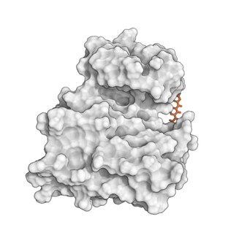
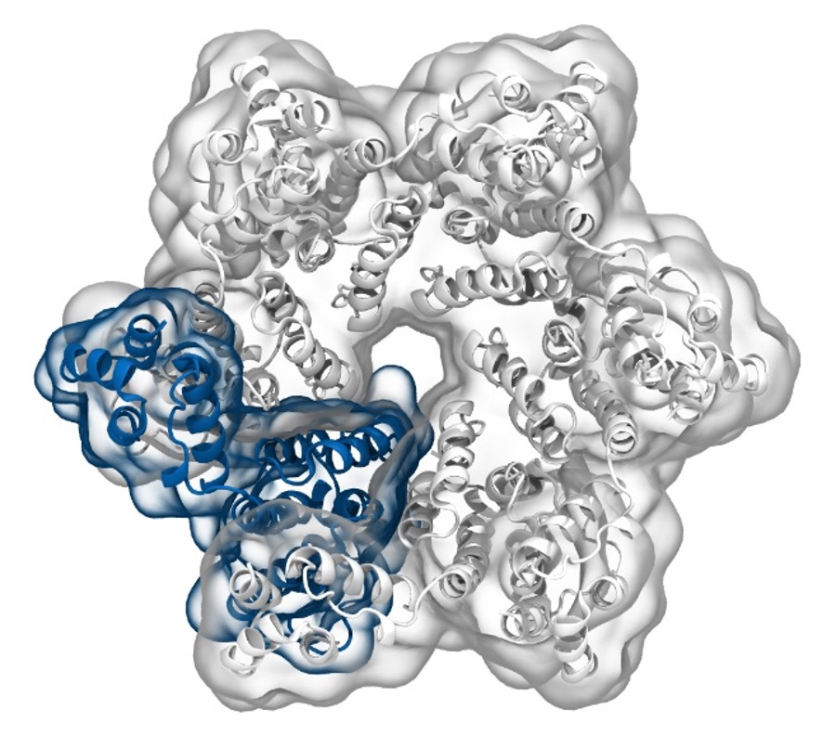
Simulation of Biomolecules
Lecture 2:
Protein preparation
2024 CCP5 Summer School
Dr Matteo Degiacomi
Durham University
matteo.t.degiacomi@durham.ac.uk
Dr Antonia Mey
University of Edinburgh
antonia.mey@ed.ac.uk

Slide 2


A typical workflow for molecular dynamics
Get protein structure
pdb api
pdb2gmx
RDkit
OpenMM tools
Prep for simulation
Amber tools
[…]
GUI, TCL, bash, python, Perl … get creative
Simulation setup
Gromacs
OpenMM
Python API
Run Simulation Protocol
Amber
NAMD
DLPoly
SOMD
Charmm
mostly C++
commandline
BioSimSpace
[…]
Simulation Analysis
PyEMMA
MDAnalysis
md-analysis-tools
MDTraj
MDAnalysis
VMD
[…]
TCL, bash, python, Perl … get creative

Slide 3
Let’s get started with understanding protein structures
Get protein structure
Prep for simulation
pdb2gmx
pdb api
Simulation setup
RDkit
OpenMM tools
Run Simulation Protocol
Amber tools
[…]
Simulation Analysis
GUI, TCL, bash, python, Perl … get creative

Slide 4
Part 1: I have a protein I want to model, now what?

Slide 5
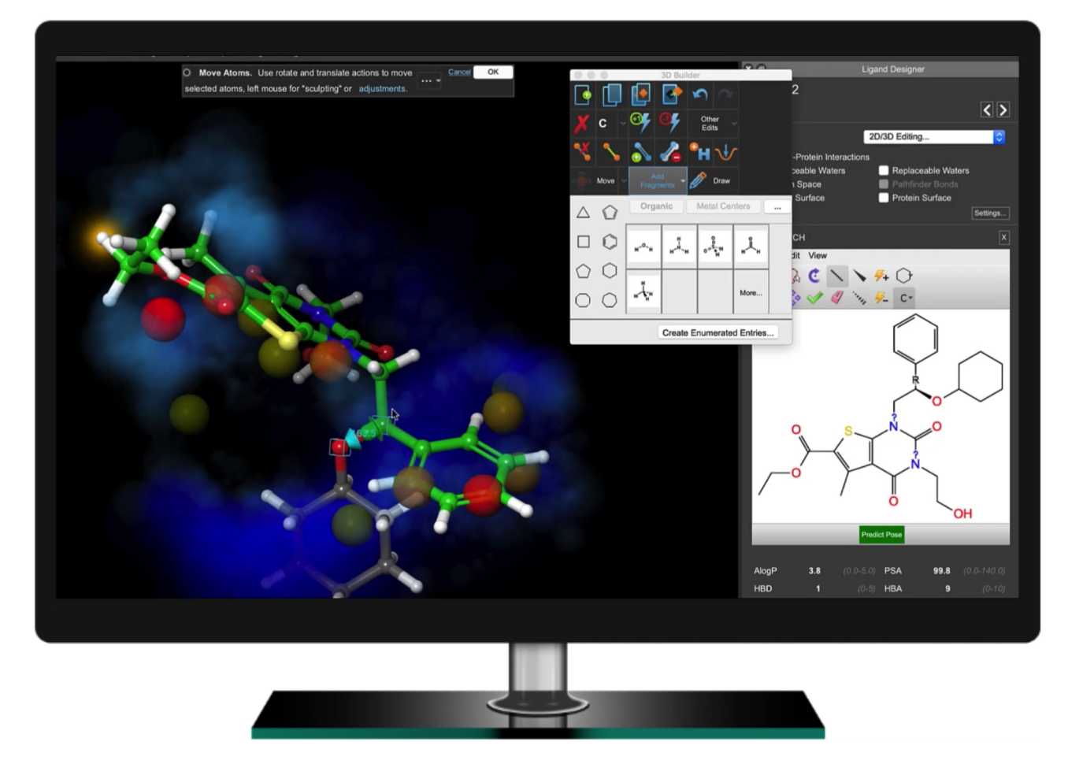
Black-box protein setup tools can help with protein prep
Flare
More on this in the afternoon

Slide 6

What things are important to look out for in protein prep?
https://www.menti.com/alc5aozap924
58950948

Slide 7
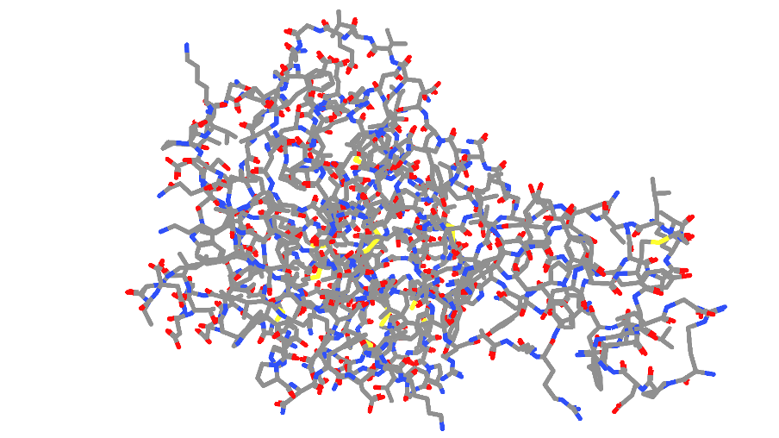

Crystal structures provide electron densities

Slide 8
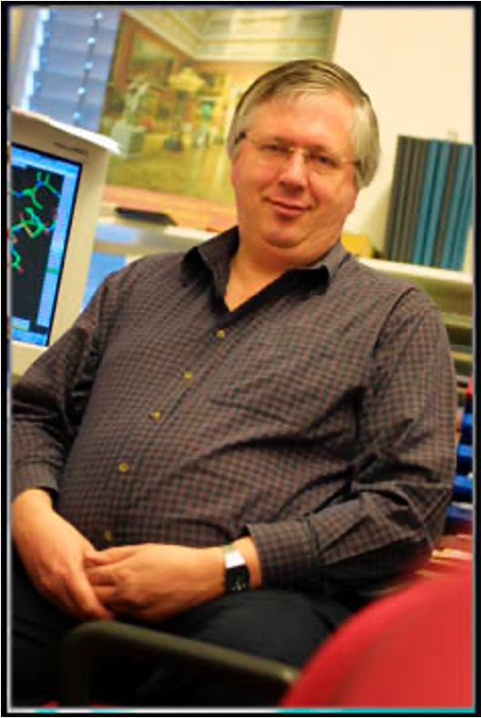
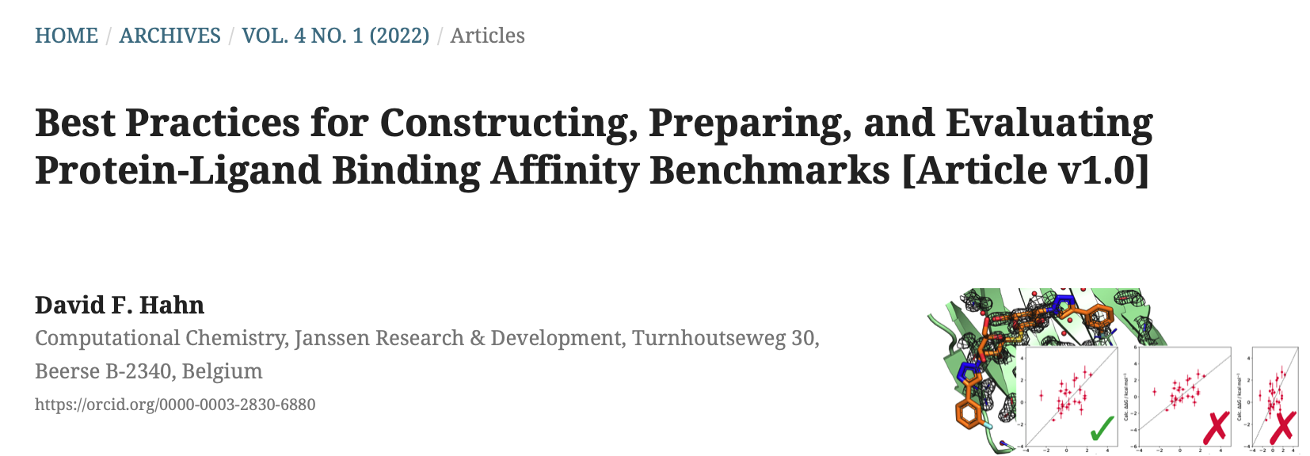
Crystal structures are models with potential errors
Examples of errors/oddities in PDB structures
https://swift.cmbi.umcn.nl/teach/pdbad/
Gert Vriend (author of WHAT_CHECK)

Slide 9
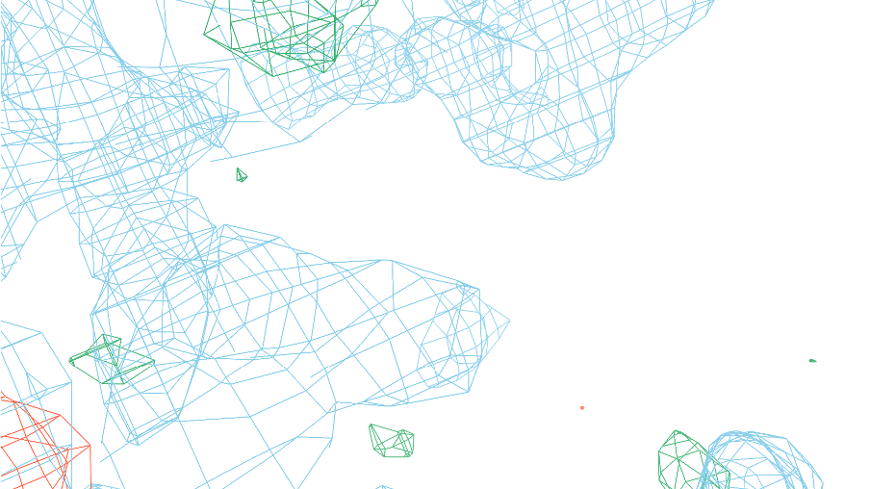
Crystal structures are models derived from electron densities
1T38: HUMAN O6-ALKYLGUANINE-DNA ALKYLTRANSFERASE
ASN157

Slide 10
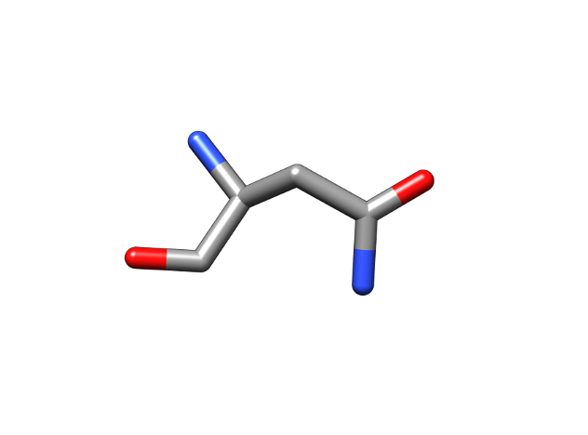
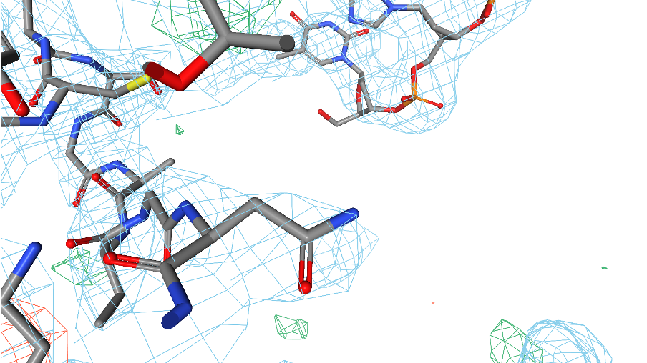
Crystal structures are models derived from electron densities
1T38: HUMAN O6-ALKYLGUANINE-DNA ALKYLTRANSFERASE
Or?

Slide 11
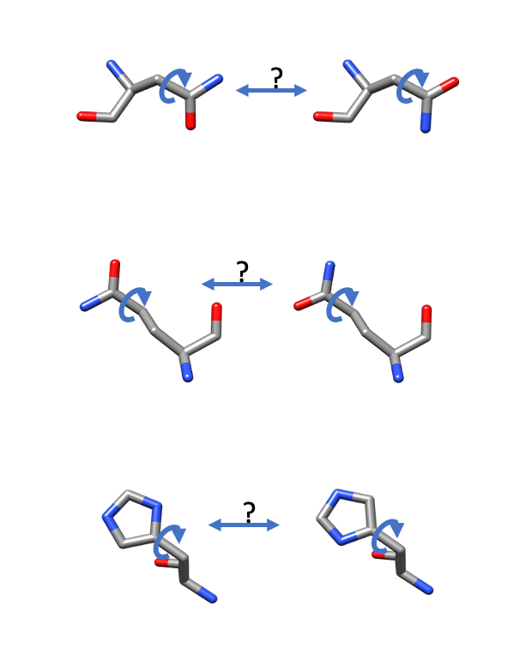
Alternative conformations of side chains - NGH flips
Typically the crystallographers will have assigned the orientation based on potential H-bonding interactions, etc.
No standard protocol for this: always worth double-checking.
Asparagine (N)
Glutamine (Q)
Histidine (H)

Slide 12
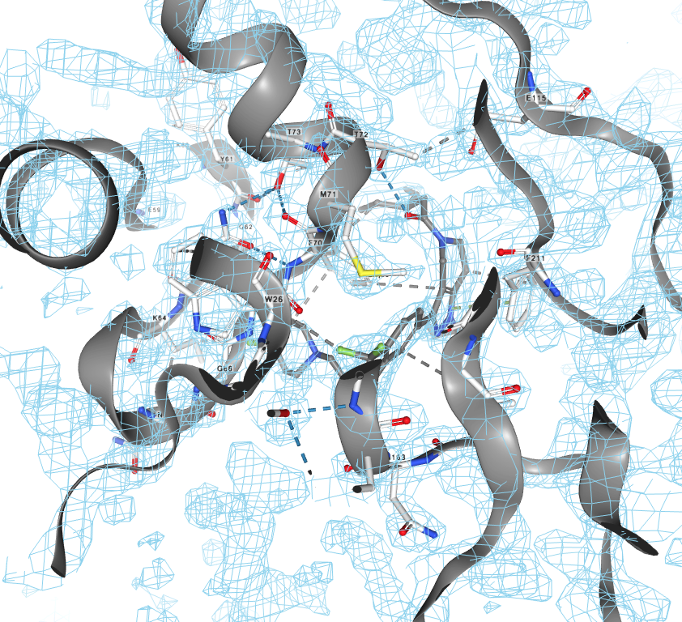
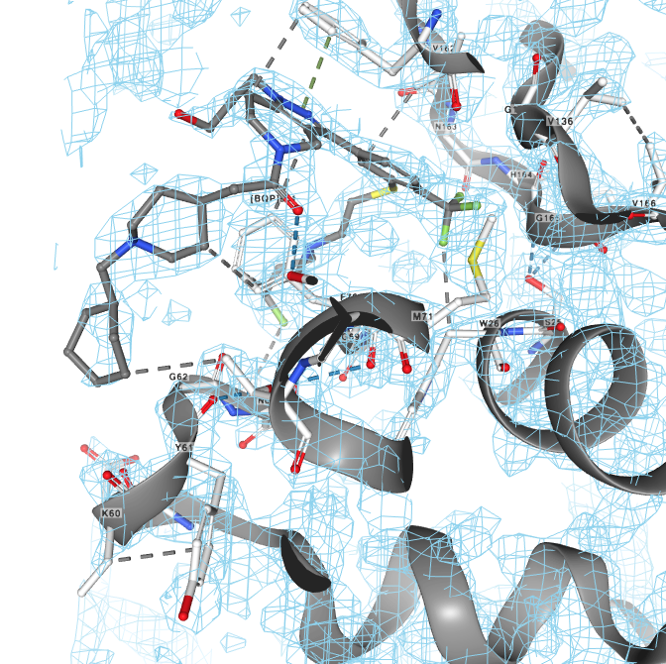
Ligand densities can also have creative input from the crystallographer
Cathepsin S
Cathepsin S with ligand
boat/chair?

Slide 13
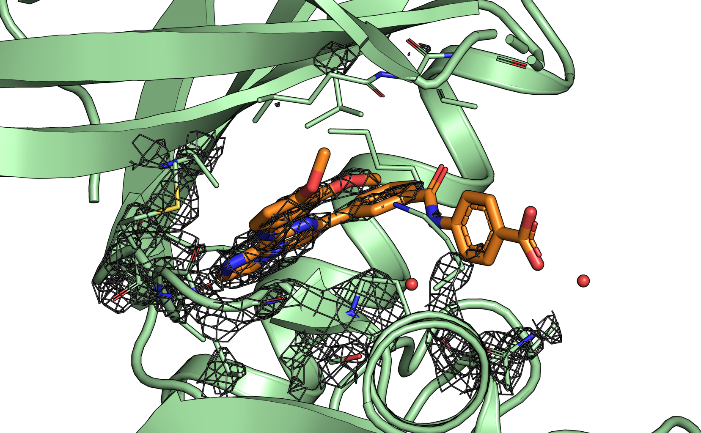
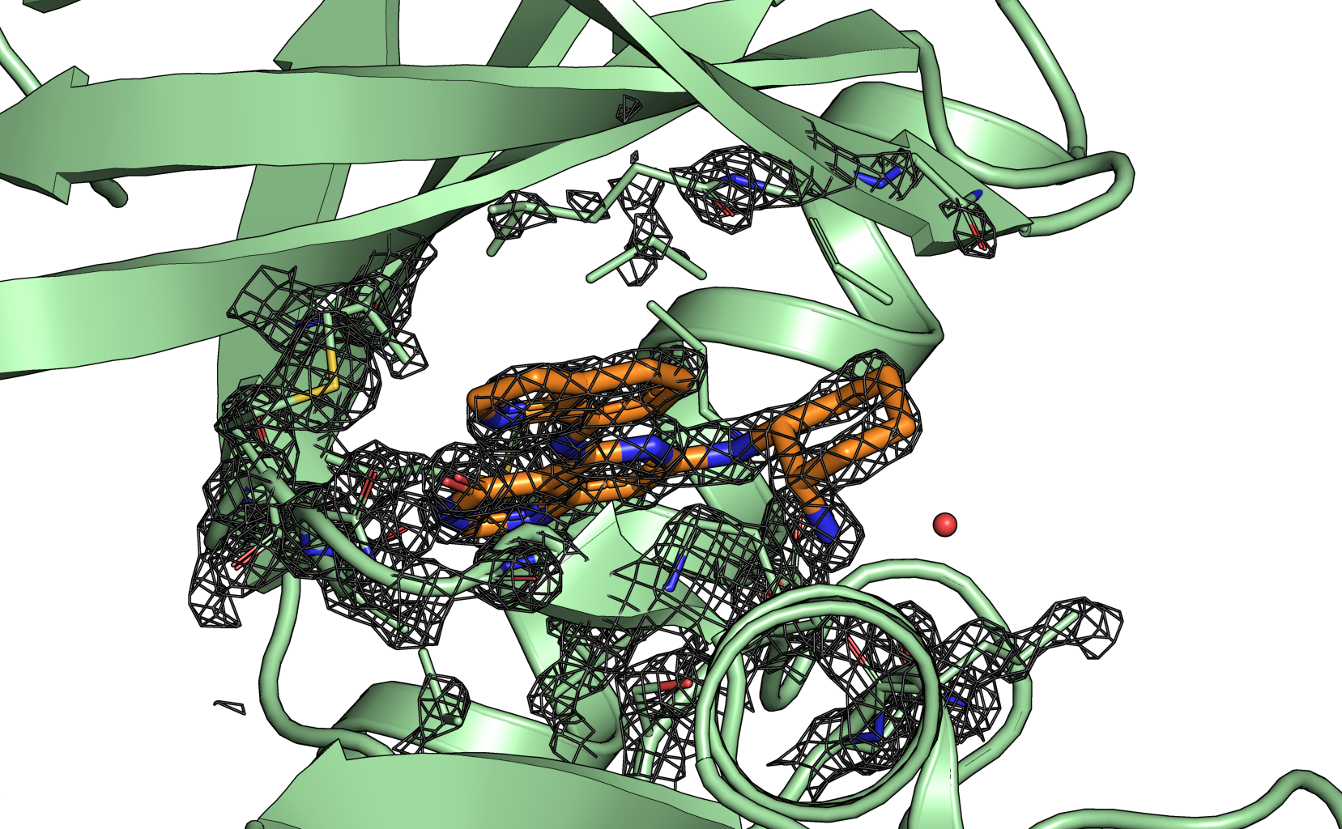
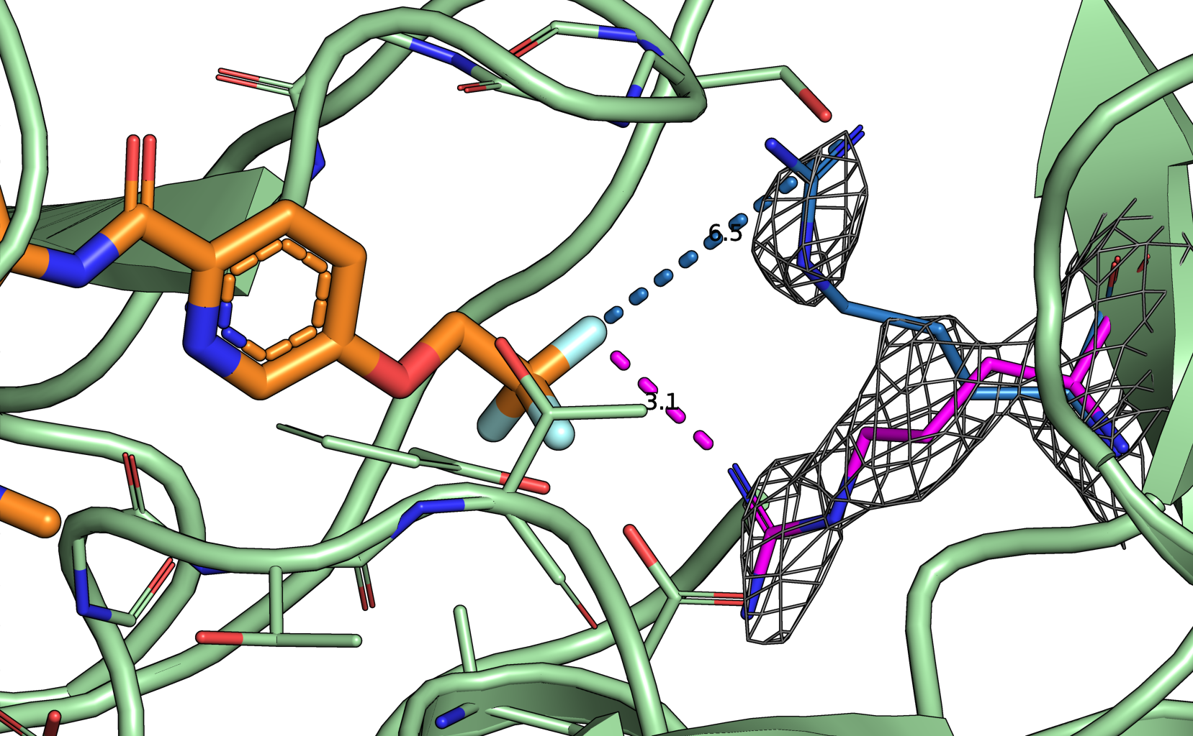
Picking the best crystal structure requires care
spleen tyrosine kinase
BACE (Hunt)
Which protein structure?
Alternative side chain conformations need to be assessed carefully
Active site residue densities are important for choosing the right crystal structure

Slide 14
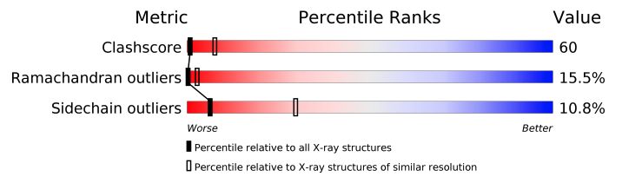
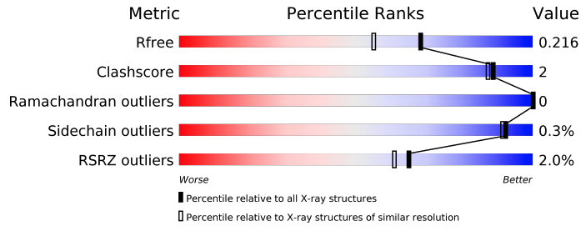
The RCSB PDB report can help with choosing structures
Jnk1 - 2GMX
Jnk1 - 3ELJ

Slide 15
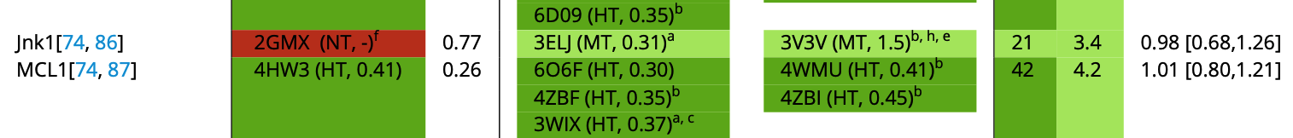
The Iridium score can help assess the trustworthiness of an X-ray structure
12 Features to inform the Iridium Score:
R-free value
Resolution
Density coverage of ligand heavy atoms
Active site density coverage
Alternative locations active site/ligands
[…]
 | HT | MT | NT
Ligand | > 0.9 | < 0.9 and > 0.5 | < 0.5
Active Site | > 0.95 | < 0.95 and > 0.5 | < 0.5
Warren et al. Drug Discovery Today (2012) 17 270-1281

Slide 16
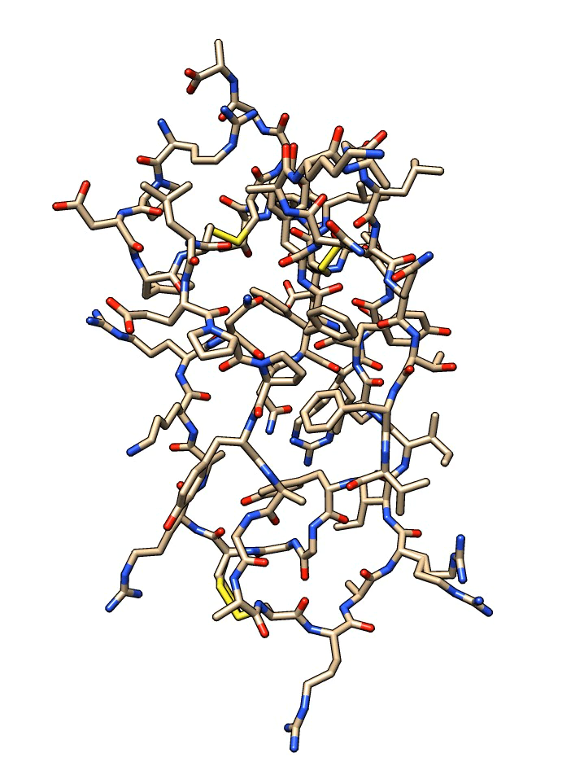
Missing information in structures: Hydrogen atoms
Missing from most crystal structures
Needed for molecular modelling
Most MD packages (AMBER, CHARMM, GROMACS, etc.) include tools to “automatically” add H-atoms.
Any issues?

Slide 17
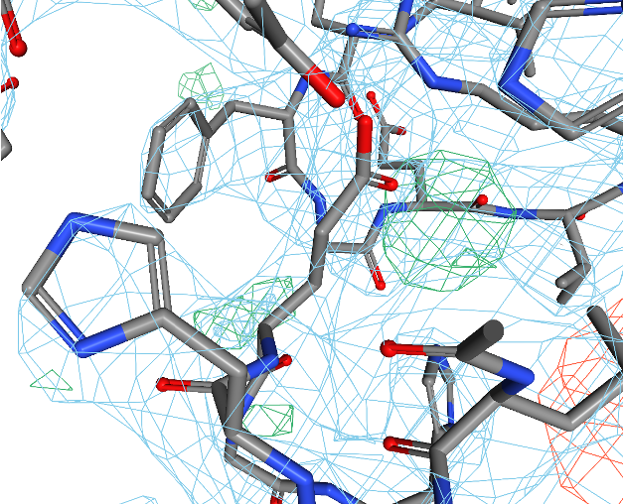
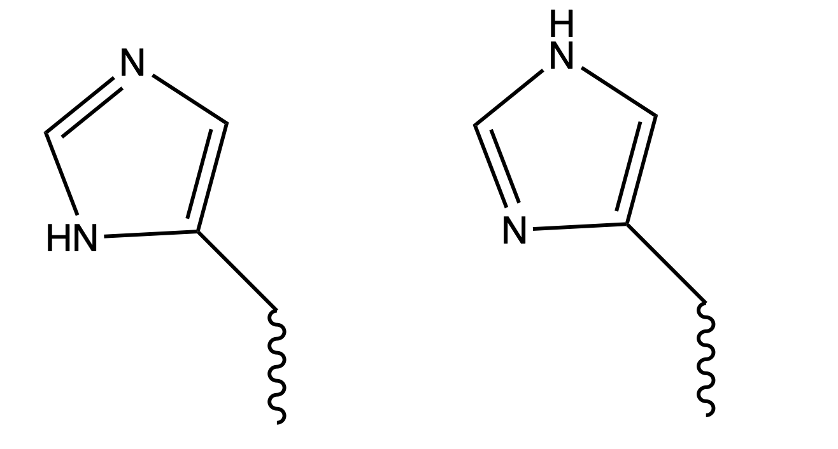
How to choose the right tautomer?
Which tautomer?
His 171
δ-tautomer
ε-tautomer

Slide 18
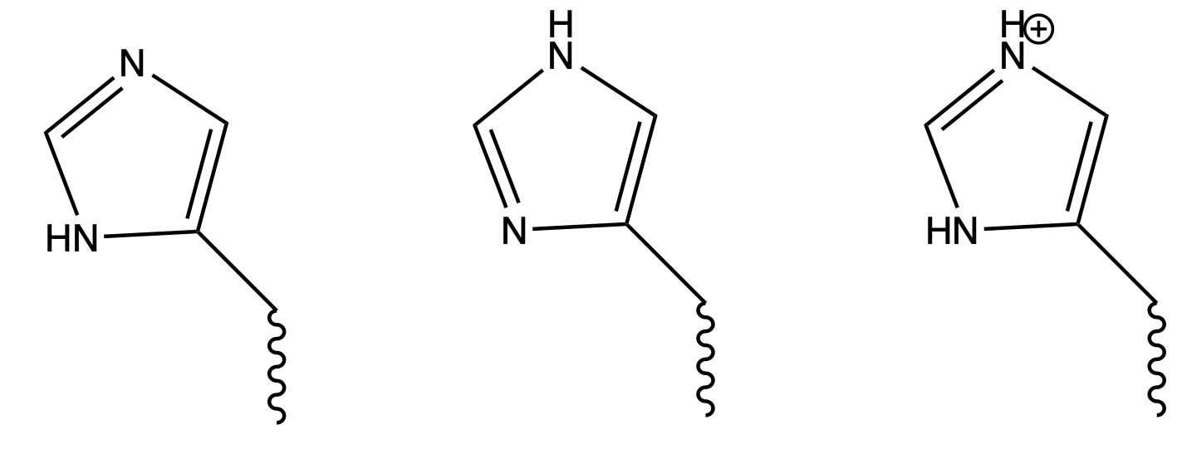
How to choose the right tautomer and protonation state?
Which tautomer and protonation?
His 171
δ-tautomer
ε-tautomer
Προτονατεδ

Slide 19
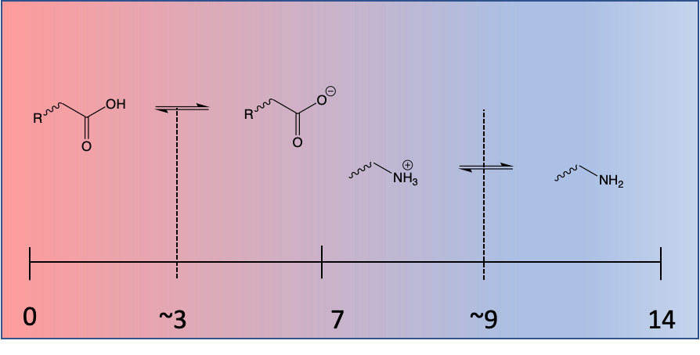
We need to worry about pKa to decide protonation
pKa: pH at which an acidic/basic group is 50% protonated/deprotonated.
pKas are not fixed things!
“Standard” values refer to the situation when the group is in dilute aqueous solution.
Groups buried in the centre of hydrophobic proteins or close to other charged groups can show large pKa shifts.

Slide 20
Amino acids that need protonation state consideration
Amino acid | pKa | options | Significance*
Aspartic acid | 3.65 | -COOH instead of COO⁻? | possible
Glutamic acid | 4.25 | -COOH instead of COO⁻? | possible
Histidine | 6.00 | protonated instead of neutral? | very possible
Cysteine | 8.18 | -S⁻ instead of SH? | very possible
Tyrosine | 10.07 | -O⁻ instead of OH? | possible
Lysine | 10.53 | –NH2 instead of NH3⁺? | possible
Arginine | 12.48 | neutral instead of protonated? | unlikely
*for a simulation around physiological pH

Slide 21
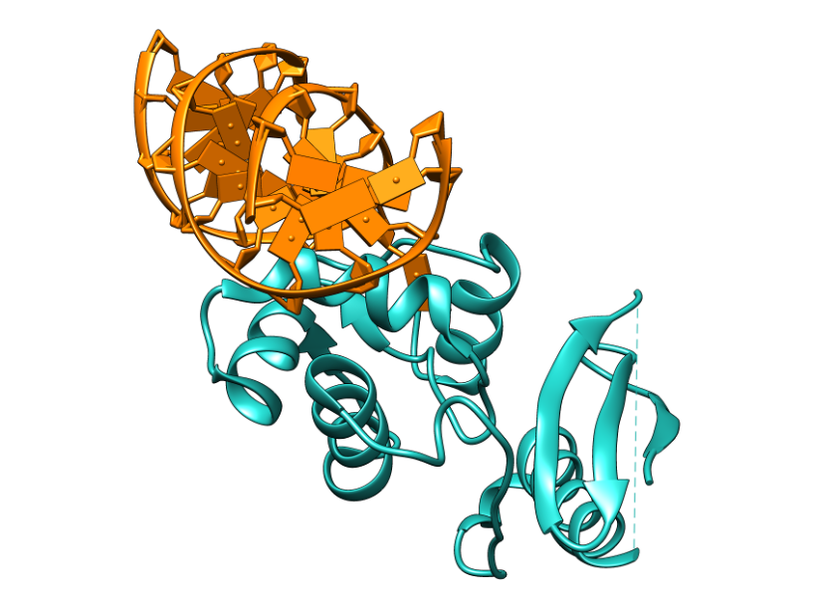
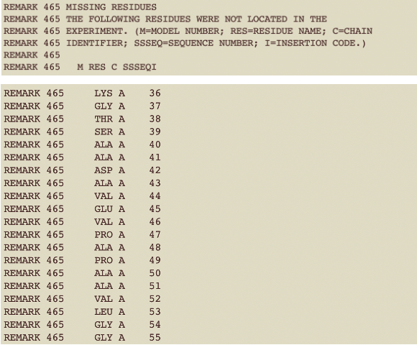
What if the best structure has missing residues?
Residues 36 to 55 missing

Slide 22
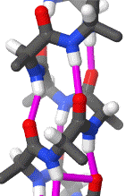
AlphaFold2 structures have no missing residues or atoms
No missing residues
Has hydrogens

Slide 23
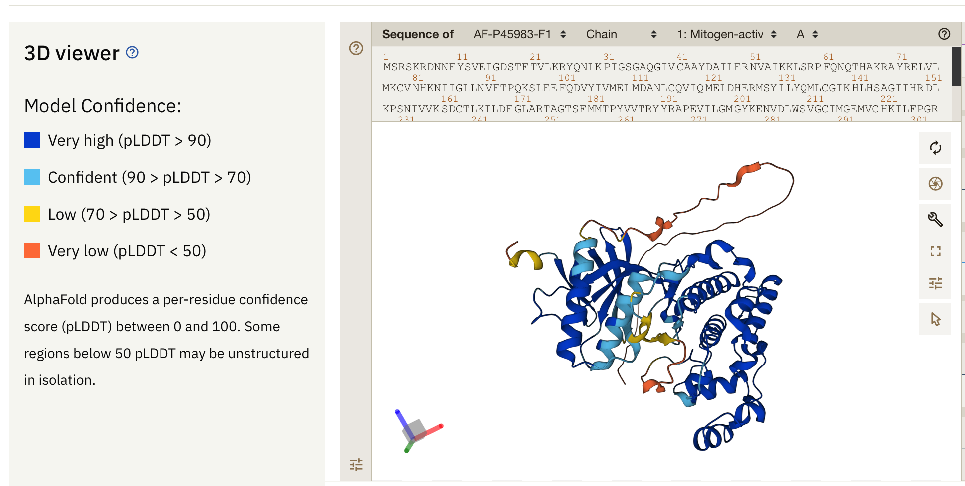
AlphaFold2 structures can have unreliable areas
JNK1 — again

Slide 24
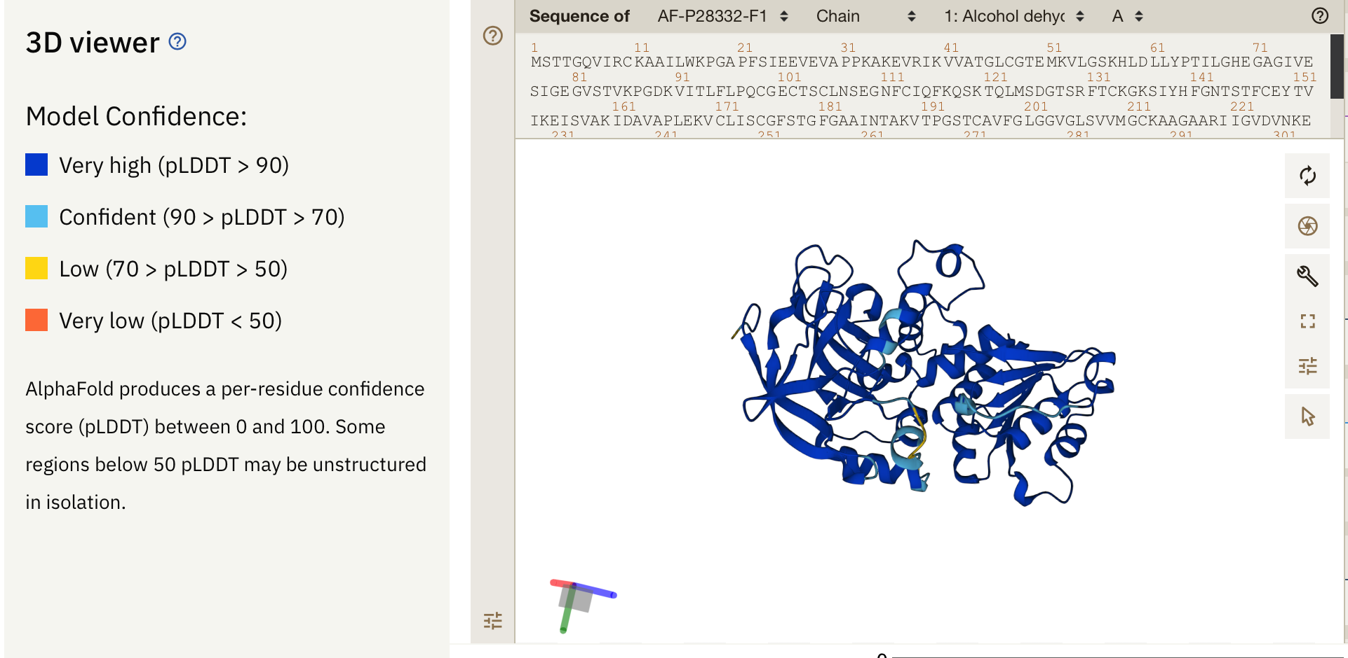
What is missing in this very good structure?
Alcohol dehydrogenase

Slide 25
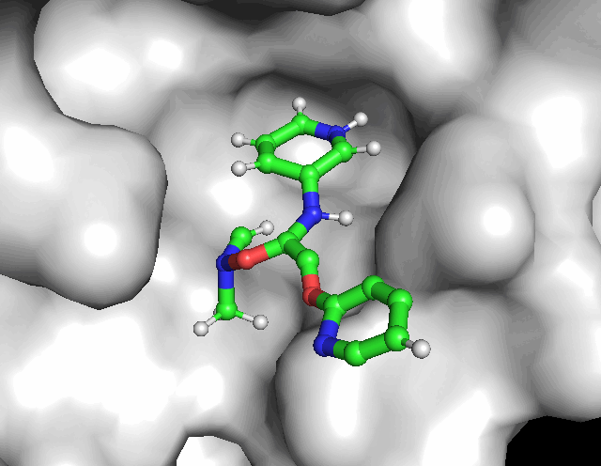
What about ligands and co-factors?
pKa for ligands is also important!
How do you get a ligand position when there is no crystal structure?
Choosing the right enantiomer

Slide 26
Trypsin: 1TRN
Task 1:
Your PhD supervisor has told you to go and simulate Trypsin and gave you 1TRN. Think about how to make choices in modelling
Have a look at the protein 1TRN in the pdb and note down what you see and choices you make
Stoichiometry (monomer or dimer protein?)
PTMs (Does it have post translational modifications?)
Non protein molecules (simulate or remove?)
Disulphides (does it have disulphides?)
Histidines (What will be the protonation state of histidines?)

Slide 27
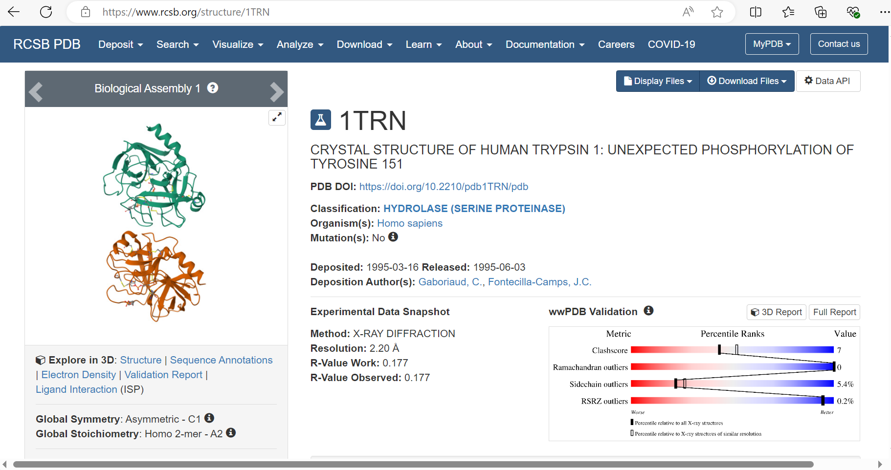
Notes:
Is it a monomer or dimer

Slide 28
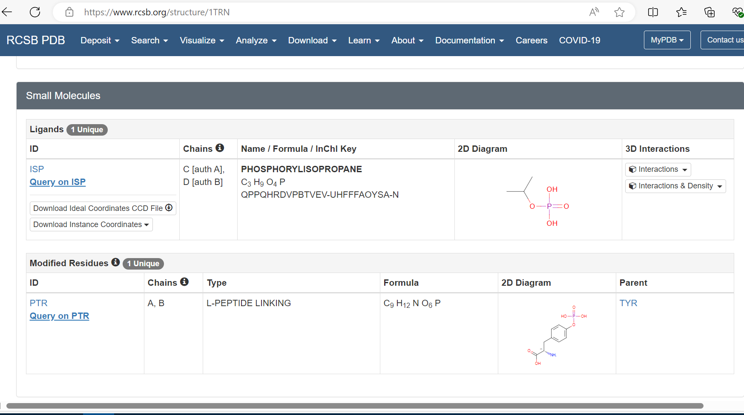
Notes:
What are non protein molecules
Go t uni port to find out more.

Slide 29
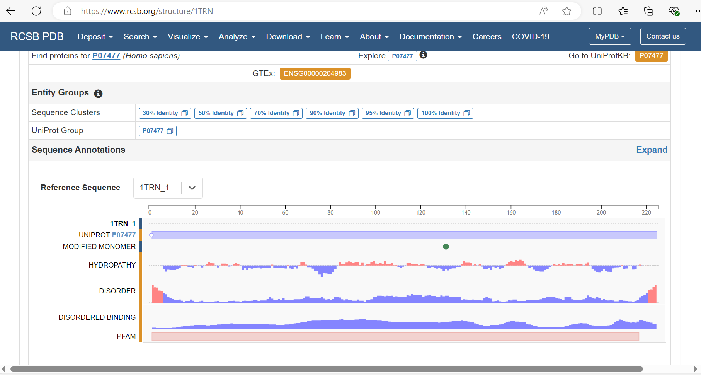

Slide 30
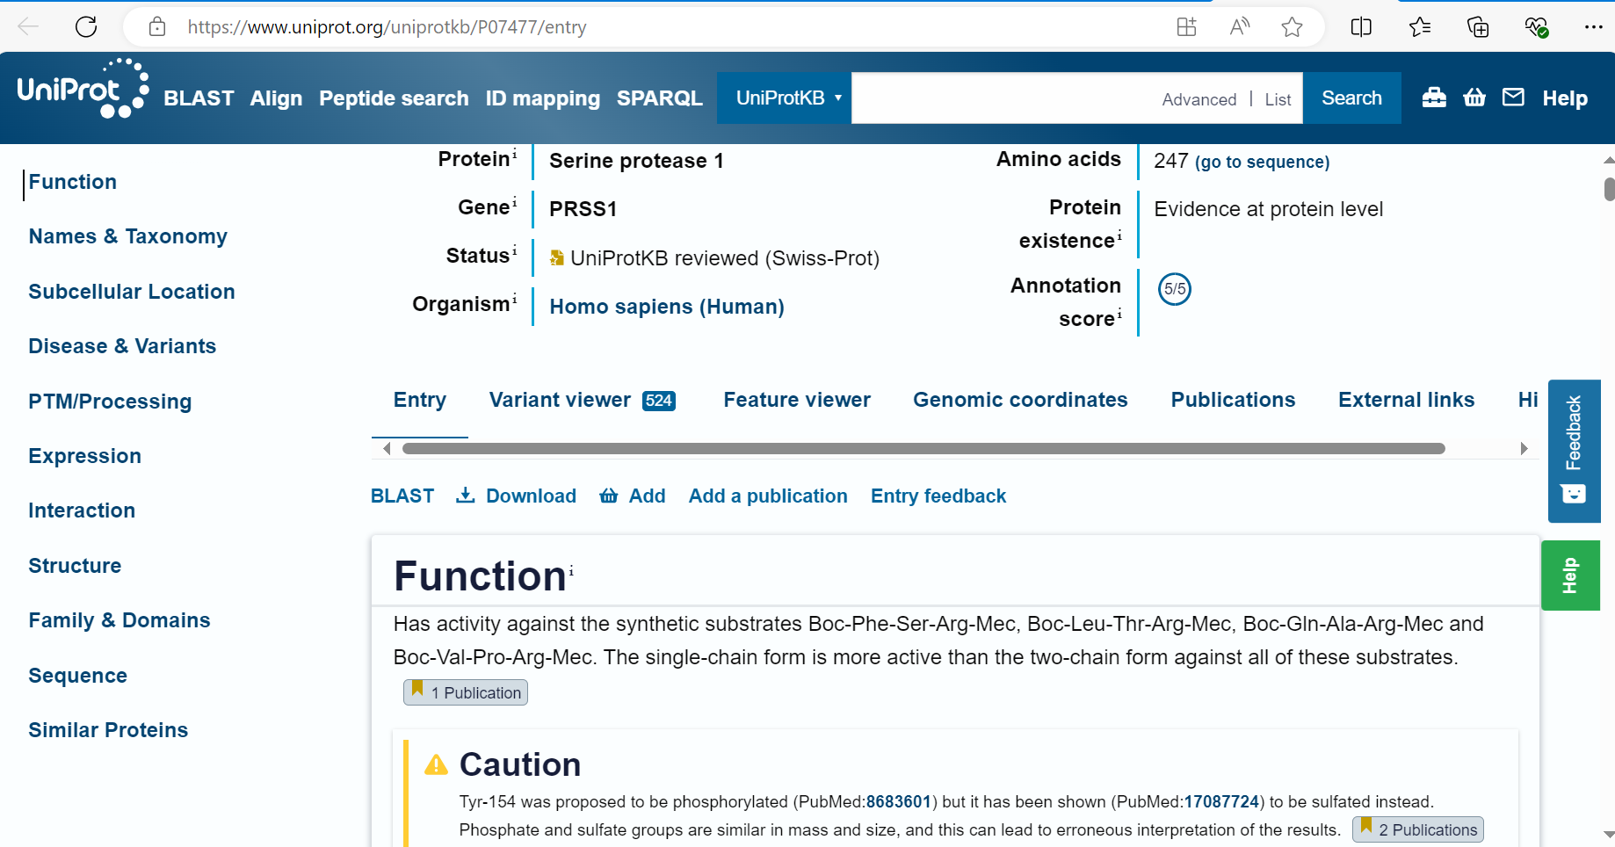
Notes:
Simulate monomeric species

Slide 31
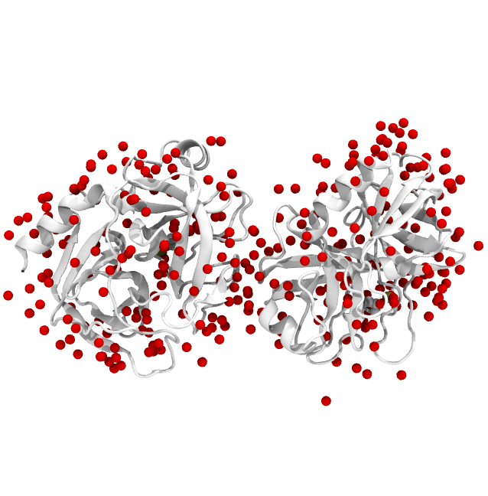
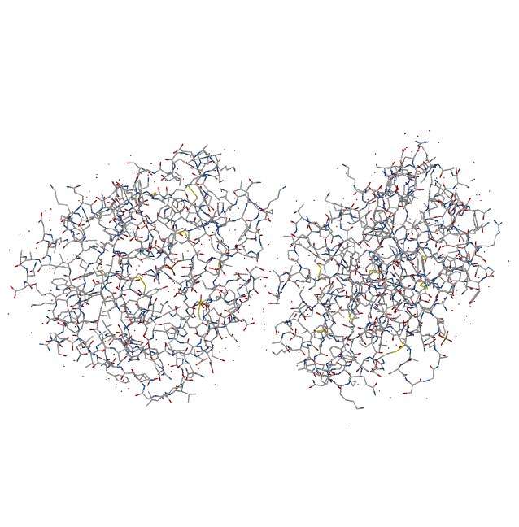
Non-protein molecules

Slide 32
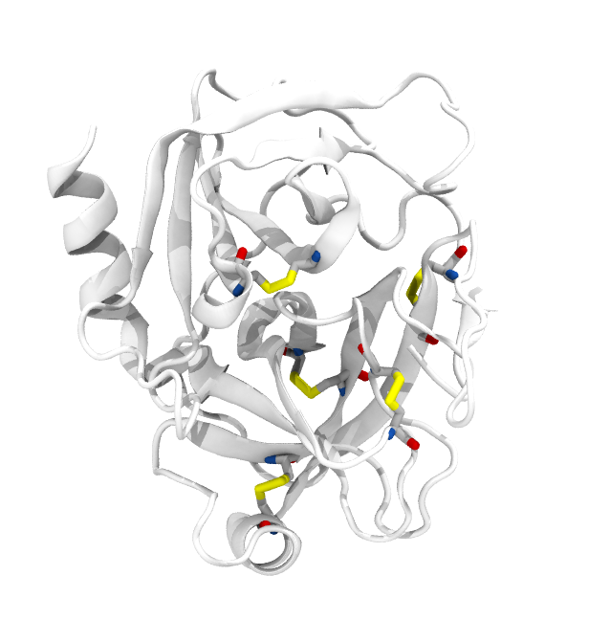
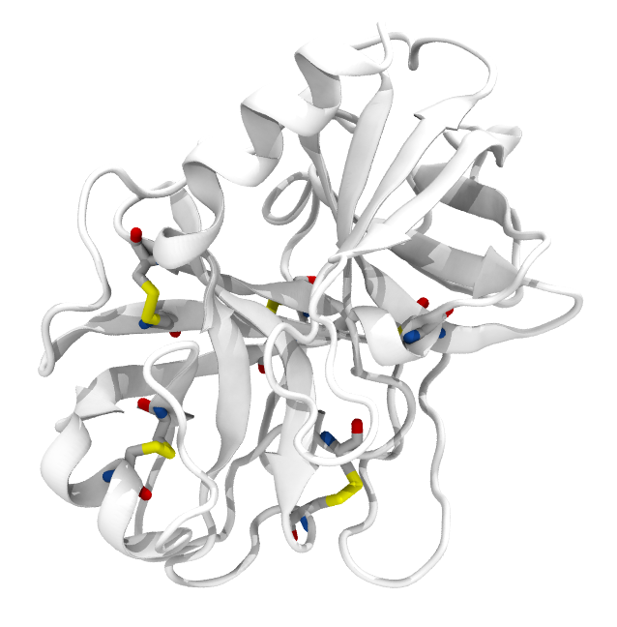
Disulphide bridges

Slide 33
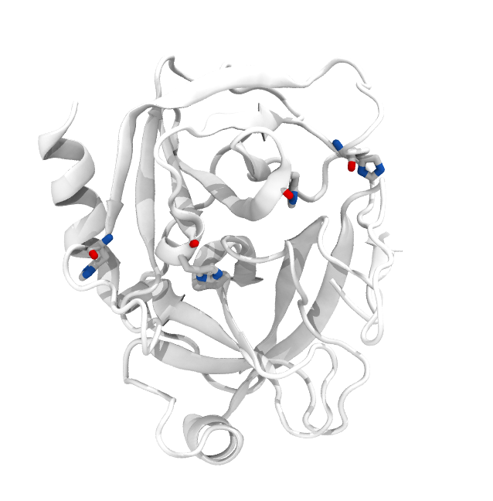
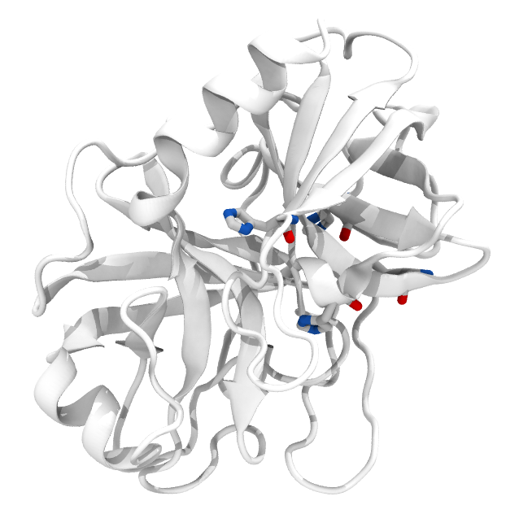
Histidines

Slide 34
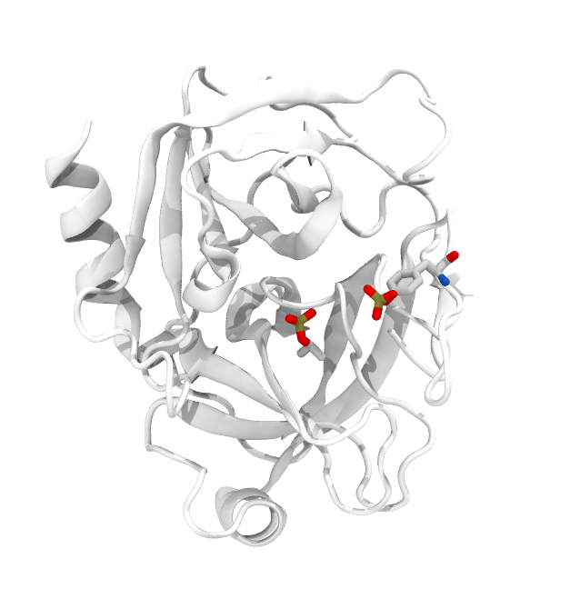
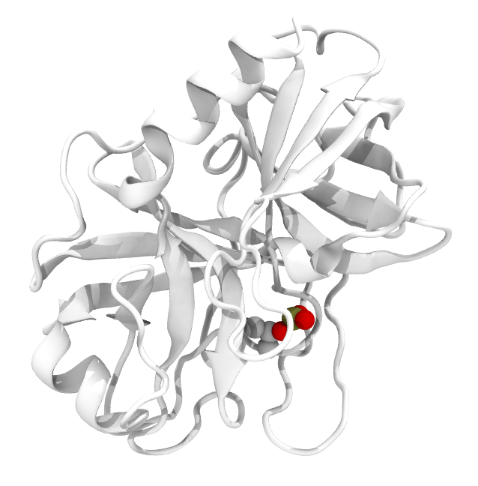
Amino acid modifications: TYR151

Slide 35
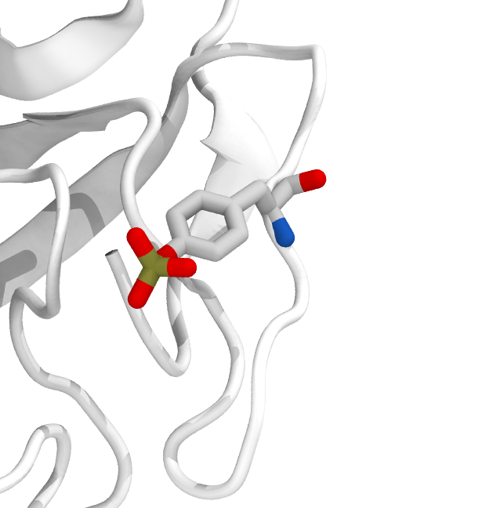
Amino acid modifications: TYR151

Slide 36
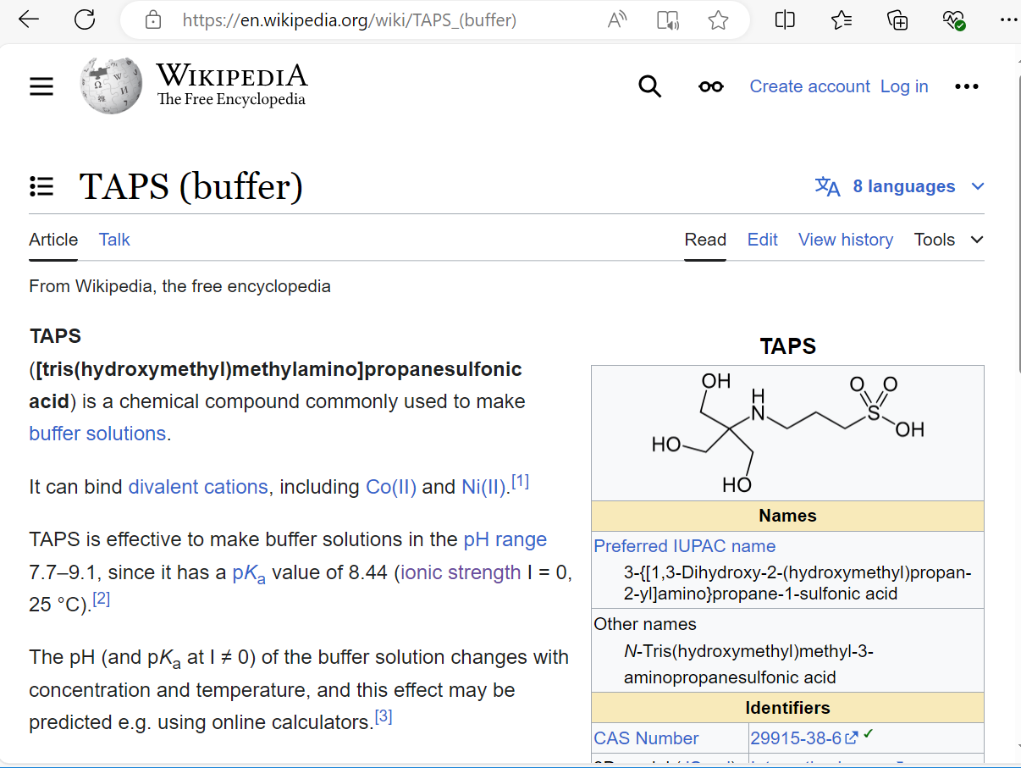
Ligand?

Slide 37
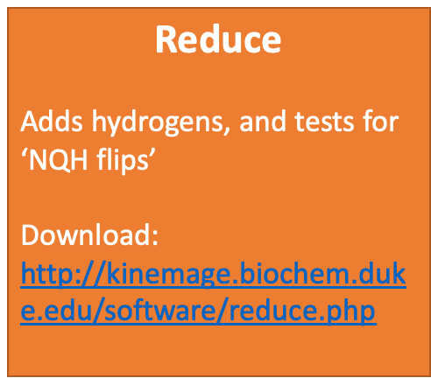
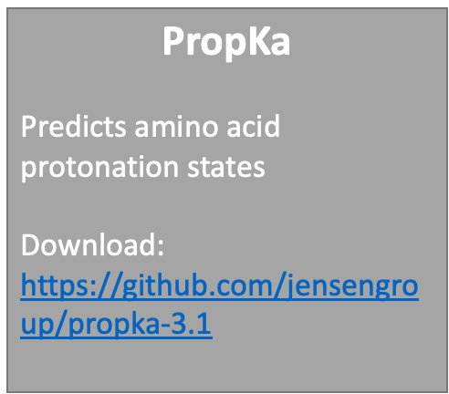
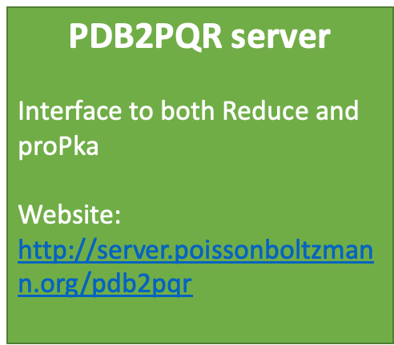
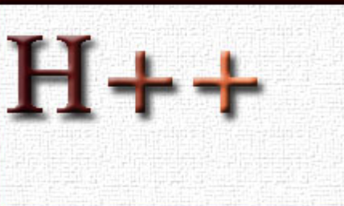
Tools that will help with all of this
Most simulation packages contain tools to help add missing H-atoms. Not all work in the same way.
Where there is more than one possible answer, not all packages will make the same decision.
There are two independent, well-established tools designed specifically to look at these issues, and a webserver that puts them together:
…

Slide 38

Let’s try some protein prep out!
uniprot.org
rcsb.org
https://server.poissonboltzmann.org
Task 2:
Identify a good crystal structure for Carboxypeptidase B2 and use the Poisson Boltzmann server to produce output for amber.
Starting structure PDB: 3D67 use uniprot to find out more!
Task 3:
Take a look at the AlphaFold 2 structure, what do you need to watch out for here?

Slide 39
Acknowledgements
Some of the material presented is adapted from Prof. Charlie Laughton

Slide 40
Next: Docking

